Slide 1
Instructions
Follow the learner instructions in the grey text boxes for each slide.
Delete the text box and instructions when complete.
Instructions for learner:
Action 1
Action 2
Action 3

Slide 2


Build a Personalized Online Course Recommender System with Machine Learning
Kavin Yudhitia
2022 10 08

Slide 3

Outline
Introduction and Background
Exploratory Data Analysis
Content-based Recommender System using Unsupervised Learning
Collaborative-filtering based Recommender System using Supervised learning
Conclusion
Appendix

Slide 4
Introduction
Project background and context
The context is about online course. We would like to create a “recommender system” to recommend a course to a user
Problem states and hypotheses
Exploration on approaches to create recommender system.
Based on item genre
Based on user preference
Based on other user that has similar preference

Slide 5
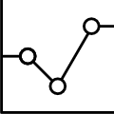
Exploratory Data Analysis

Slide 6
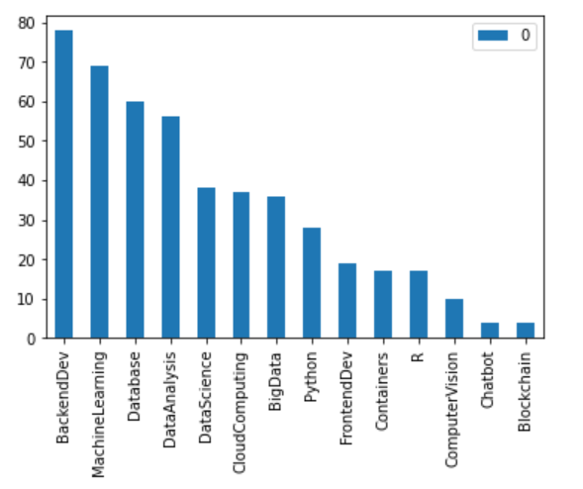
Course counts per genre
Backend Dev, Machine Learning, and Database are the top 3

Slide 7
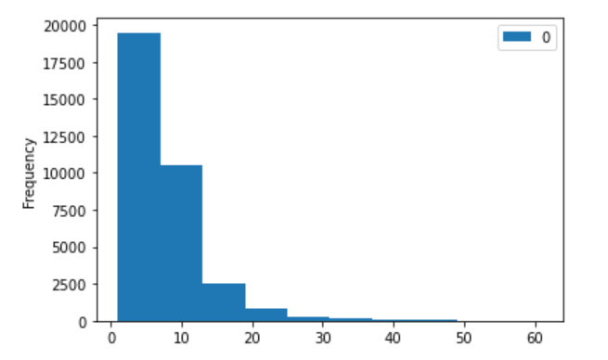
Course enrollment distribution
Most user rated ~10 items. The frequency got lower the more the items.

Slide 8
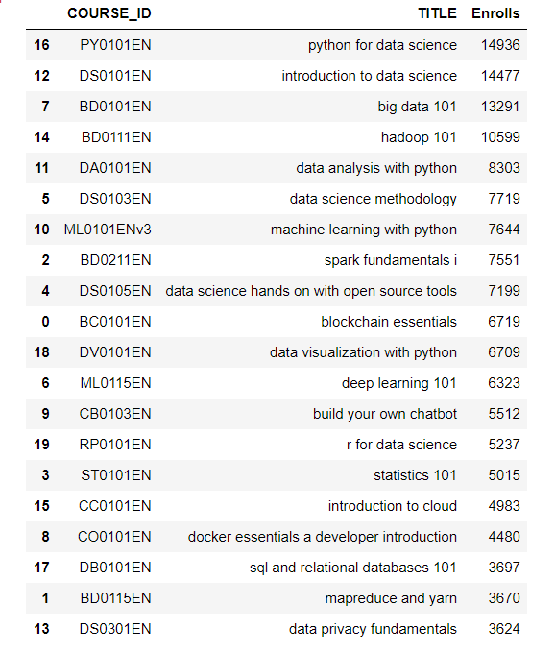
20 most popular courses
Below are the most popular 20 courses. The top 3 are all related with data science.

Slide 9
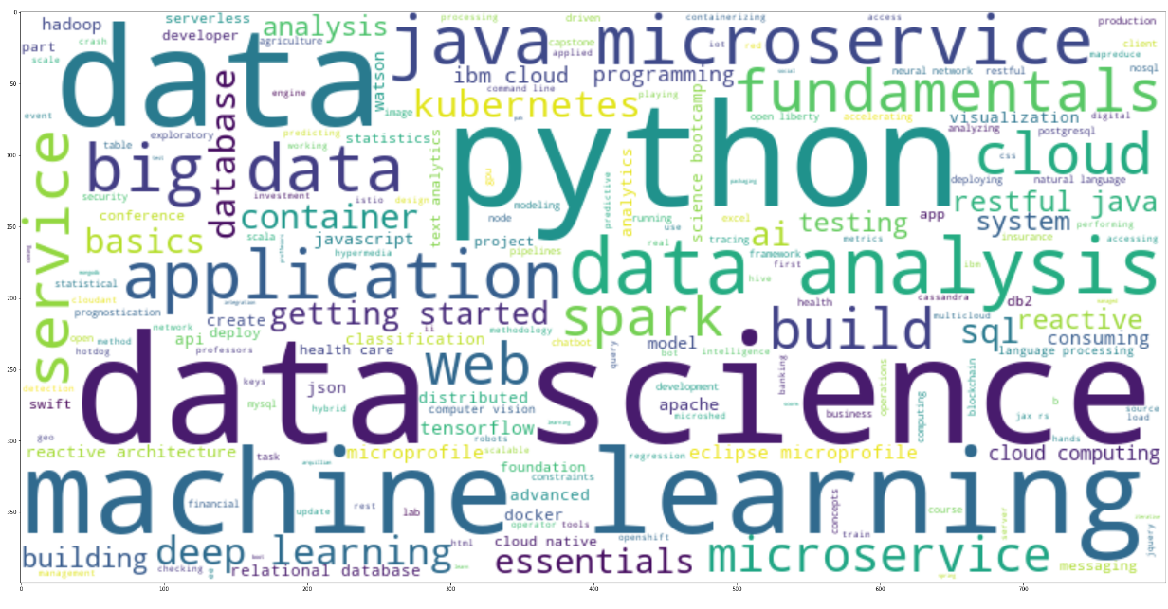
Word cloud of course titles
There are many popular IT related keyword such as data, python, machine learning, data science.

Slide 10
Content-based Recommender System using Unsupervised Learning
Cluster2
Cluster1

Slide 11
Flowchart of content-based recommender system using user profile and course genres
-In short: Based on the user history of learning, the system can recommend other courses that is similar with the user interest (user rating) in the past.
Raw data: User profile and Course genre
Find unknown courses for each user
Score each unknown courses VS user profile
If score > threshold, then the course is recommended

Slide 12
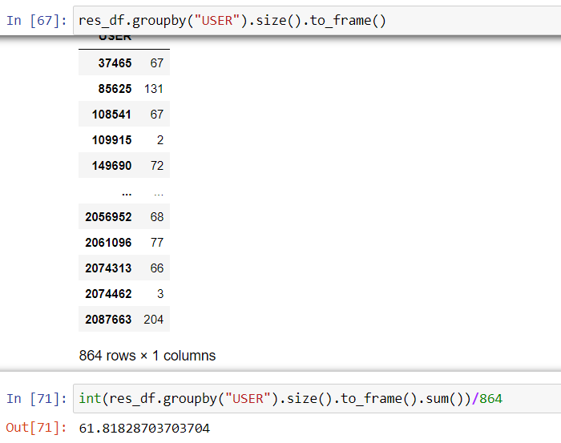
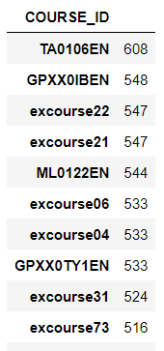
Evaluation results of user profile-based recommender system
score_threshold = 10.0
On average, how many new/unseen courses have been recommended per user (in the test user dataset)
top-10 commonly recommended courses across all users
# new/unseen courses have been recommended per user

Slide 13
Flowchart of content-based recommender system using course similarity
- In short: Recommend another course that is “similar” to the course that the user has enrolled in the past.
Generate similarity matrix for each courses to other courses
For each user, get the list of “Enrolled course” and “unselected course”
For each “unselected course”, check the similarity score with the “enrolled course”
If score > threshold, then the course is recommended

Slide 14
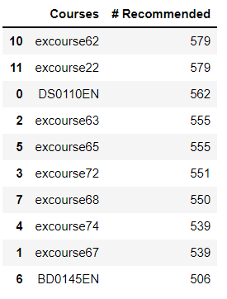

Evaluation results of course similarity based recommender system
threshold = 0.6
# new/unseen courses have been recommended per user (in the test user dataset)
top-10 commonly recommended courses
Total 1000 user

Slide 15
Flowchart of clustering-based recommender system
In short: Firstly, group the users based on their interest. Then, the courses that fall into the same group will become “recommended course” for users in the same group.
Create “user profile vector” ← What user interested in what topic
“Group” the user based on their interest by clustering algorithm
It becomes the “recommended course” for the user
For each user, find courses in the “Group” that he/she has not taken yet

Slide 16
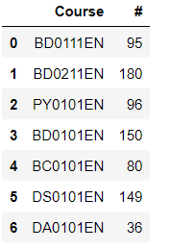

Evaluation results of clustering-based recommender system
Threshold = 70
K for clustering = 18
#new/unseen courses have been recommended per user (in the test user dataset)
Surprisingly, not many, probably the K chosen is too big or the threshold is too high
top-10 commonly recommended courses

Slide 17
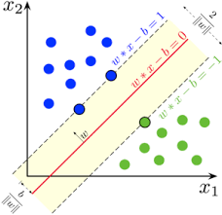
Collaborative-filtering Recommender System using Supervised Learning

Slide 18
Flowchart of KNN based recommender system
In short: Firstly, train a KNN model (using Surprise library) with a user’s rating to a course. This model then can predict a user’s rating to an unknown course. The prediction can be used to create recommendation for another course he/she hasn’t taken yet
Train a KNN model with a known data set of user’s rating to a course
This model can then predict a user rating to another course that he/she has not taken yet
This prediction can be used to create recommendation for another course

Slide 19
Flowchart of NMF based recommender system
-Previously we have used KNN, which works well. Only that it takes spaces to store all information. It means, if there is 10000 user x 1000 course, then all of them has to be stored.
NMF is an estimation model to reduce the space required. This can be obtained by selecting the most important feature only. So, unlike KNN that will store 10000x1000, this will store 2 matrices of 1000x16 + 1000x16. (16 in this example is the selected feature)
NMF will also take time to compute to get similarity score
Train a NMF model with a known data set of user’s rating to a course
This model can then predict a user rating to another course that he/she has not taken yet
This prediction can be used to create recommendation for another course

Slide 20
Flowchart of Neural Network Embedding based recommender system
Base idea is: the input of the neural network will be “one-hot encoded” matrix of “user” and “item”.
“one-hot encoded” matrix is quite “sparse”, meaning that there is many zeroes (e.g. 10000x1 matrix with only 1 non-zero value). So, instead of just passing this raw data, we can optimize the model by using “embedding layer” to transform the “one-hot encoded” matrix to a denser matrix, let’s say 16x1. Then it can be processed normally.
USER as a one-hot encoded vector
embedding layer
USER as embedded vector
Dot product
Activation function
Rating
USER as a one-hot encoded vector
embedding layer
USER as embedded vector

Slide 21
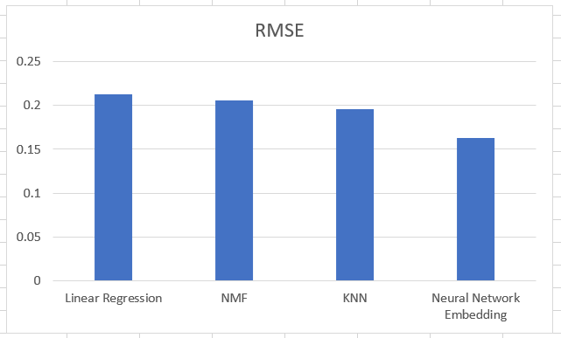
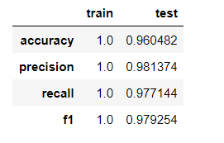
Compare the performance of collaborative-filtering models
Below are the summary of the models created in this exercise. The RMSE is between 0.15 – 0.22 with Neural Network having the lowest result.
For classification model, Decision tree is used with overall performance > 96%
For Decision tree model:

Slide 22
Conclusions
Recommender system may be built with different approaches:
Based on item genre
Based on user preference
Based on other user that has similar preference
Several different machine learning algorithm can be used as predictive model.
In this exercise, Neural Network has the best result.

Slide 23
Appendix
Instructions for learner:
Include any relevant assets like a GitHub repo, key Python code snippets, charts, notebook outputs, or deployed Streamlit app URLs that you may have created during this project
Asset 1
Asset 2
Asset 3
Asset 4
…

